Slide 1
Leveraging Wikipedia as a Hub for Data Integration: the Remixing Archival Metadata Project (RAMP)
Can’t We All Work Together? Interoperability & Systems Integration
NISO Virtual Conference
November 19, 2014
Tim A. Thompson Princeton University Library @timathom

Slide 2
Outline
Project background
Origins
EAC-CPF metadata standard
Goals
Timeline
Libraries, archives, Wikipedia
Overview of the RAMP editor
University of Miami pilot project (Cuban Heritage Collection)
Impact on Web traffic
Wikipedia as a hub for data integration

Slide 3
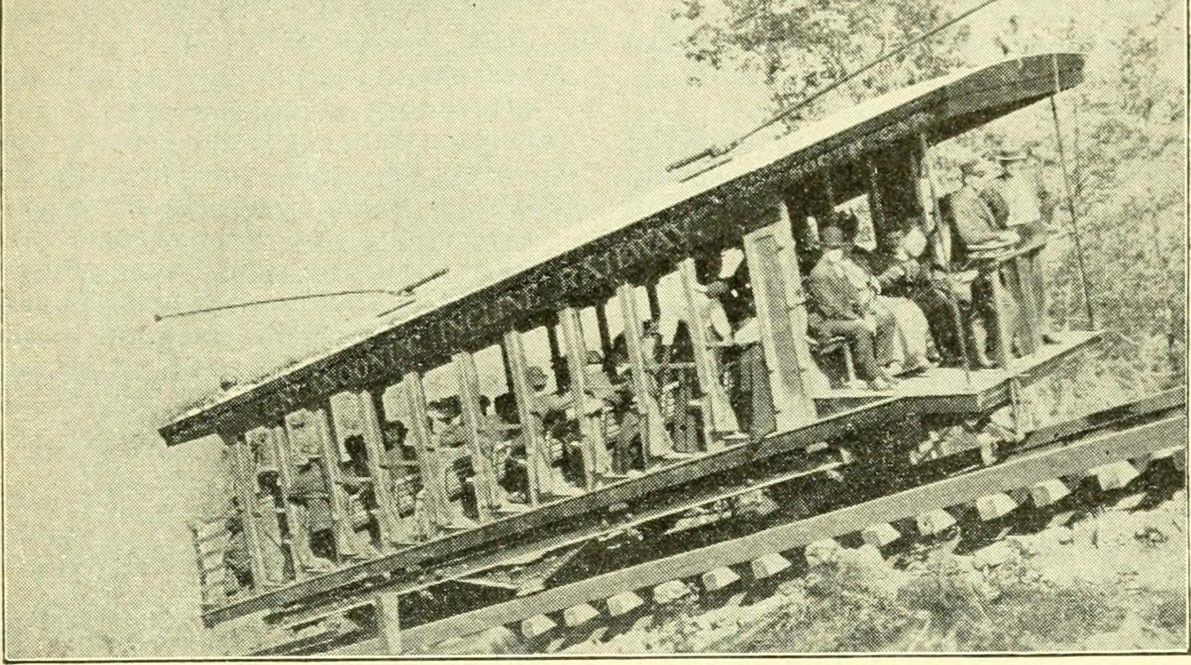
Background

Slide 4
Origins
Digital collections at the University of Miami
Collaboration among librarians, archivists, technologists
Archival metadata standards
Encoded Archival Description (EAD) for finding aids
Encoded Archival Context–Corporate Bodies, Persons, and Families (EAC-CPF) for creator records

Slide 5
EAC-CPF Metadata Standard
EAC-CPF is an (XML) encoding schema …
Designed to encode standardized information about:
People and organizations associated with archival collections
The social context and networks of those people and organizations
Explicit encoding of relationships makes EAC-CPF “linked data ready.”
EAC-CPF homepage | Tag Library

Slide 6
Goals: Access and Integration
Archivists have a strong tradition of contextual description: why not expand its reach?
Core values of the library community such as equal access to information, intellectual freedom, and the objective stewardship and provision of information must be preserved and strengthened in the evolving digital world (ALA Code of Ethics).

Slide 7
Project Development Timeline: 2013
EAC-CPF workshop
User stories
Development sprints (3 x 2)
Usability testing
Code4Lib article
| | | | | |
Mar. May June July Aug. Oct.

Slide 8
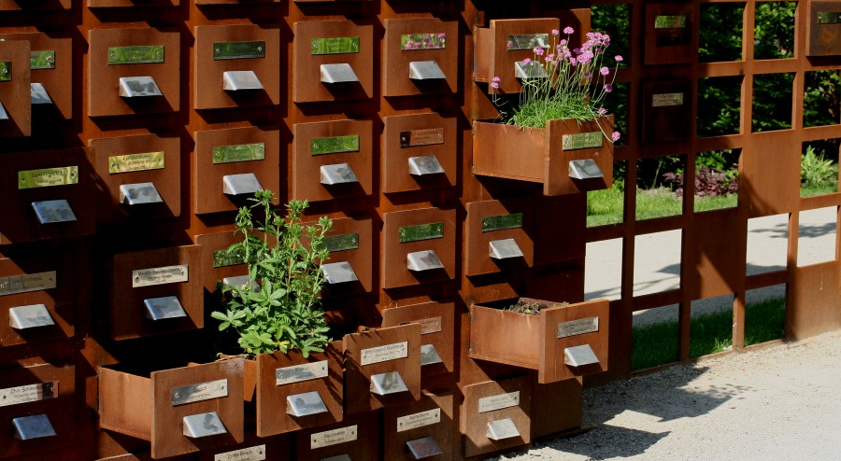
Libraries, Archives, Wikipedia

Slide 9


Why Wikipedia?
Wikipedia is the world’s seventh largest website, and as information professionals we can’t afford to ignore it.
It’s a natural partner for cultural heritage institutions.
National Archives: 76.8% of materials viewed online in 2013 were accessed via Wikipedia
(McDevitt-Parks and Lange, 2014)
OCLC webinars:
Wikipedia and Libraries: Increasing Your Library’s Visibility (The Wikipedia Library and others)
Dec. 8, 2014: Improving Wikipedia Articles Show and Tell

Slide 10
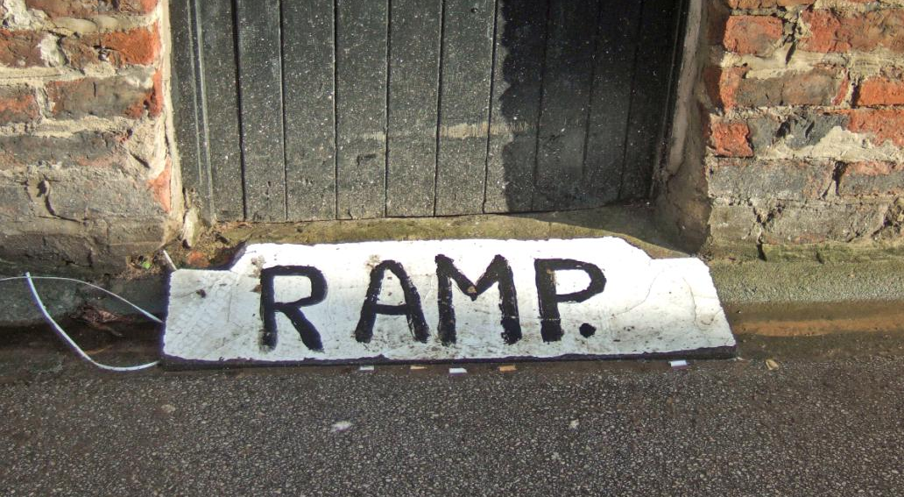
Remixing Archival Metadata Project

Slide 11
Overview of the RAMP editor
Open source, browser-based tool:
https://tools.wmflabs.org/ramp/ (demo instance)
Derives, creates, and enhances EAC-CPF records
Extracts relevant data from EAD files
Pulls in external data from OCLC APIs:
Virtual International Authority File (VIAF)
WorldCat Identities
Transforms EAC-CPF records into wiki markup
Direct publication to English Wikipedia through its API
Detailed installation instructions on GitHub:
https://github.com/UMiamiLibraries/RAMP

Slide 12
RAMP System Overview
Export
EAC-CPF
EAD
Publish
Import
Wikipedia
Transform
XSLT
WorldCat
Save
Edit
Ingest
MySQL
Ace (JavaScript)
PHP
JavaScript (jQuery)
VIAF

Slide 13
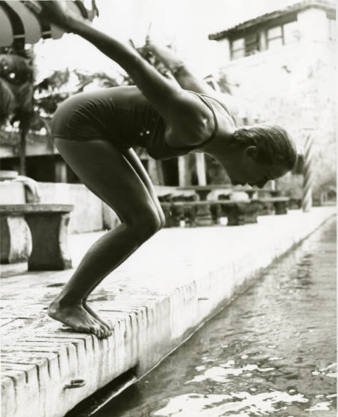
UM Pilot Project
Pilot Project: CHC Theater Collections

Slide 14
Pilot Project: CHC Theater Collections
Theater Collections in the Cuban Heritage Collection
LibGuides: http://libguides.miami.edu/chctheater
32 collections total
Wiki pages for 18 collections
Timeline: April–May 2014
Time spent: approximately 1 hour per page

Slide 15
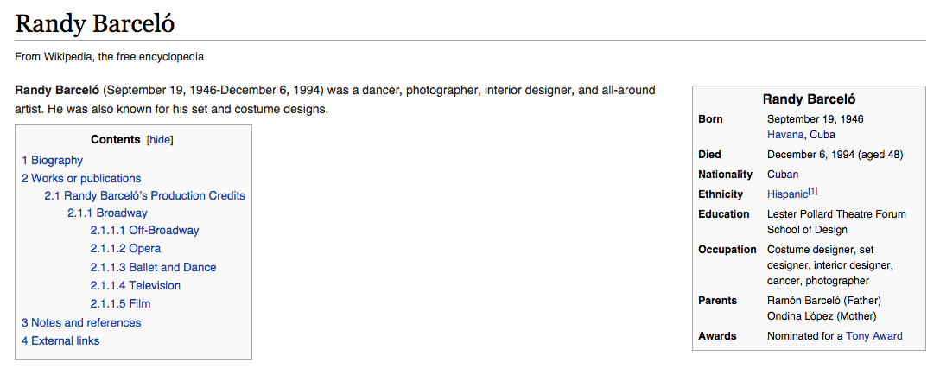
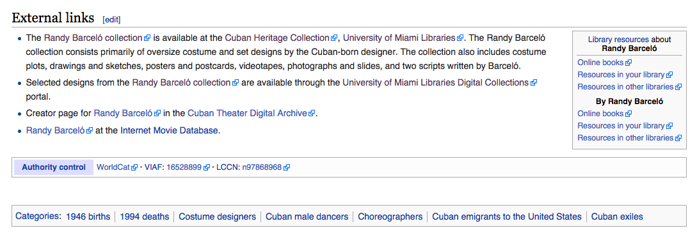
Wikipedia Pages: External Links

Slide 16
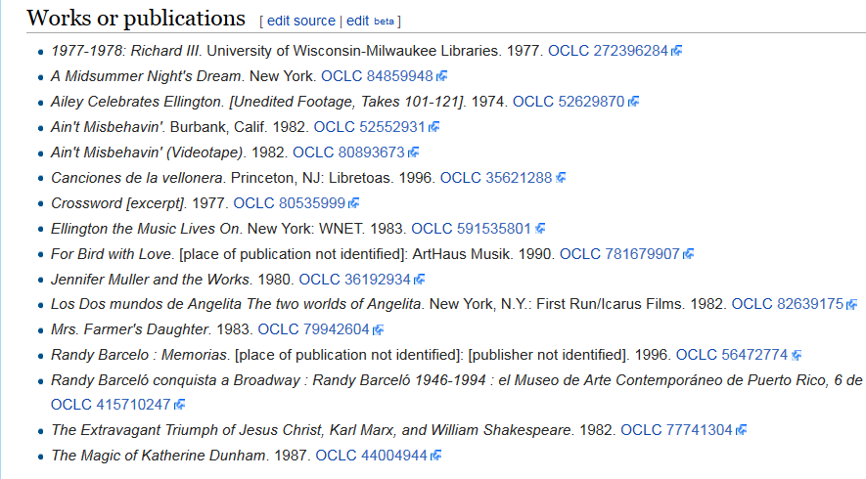
Wikipedia Pages: Citation Templates

Slide 17
Wikipedia Pages: Citation Templates
* {{Citation
| title = Ain't Misbehavin'
| location = Burbank, Calif.
| publication-date = 1982
| separator = .
| oclc = 52552931
}}

Slide 18
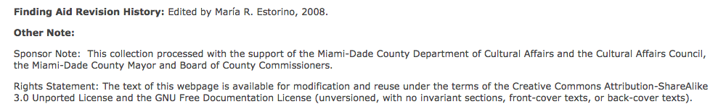
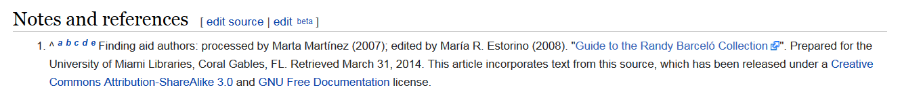
Pilot Project: Rights Statement Example

Slide 19
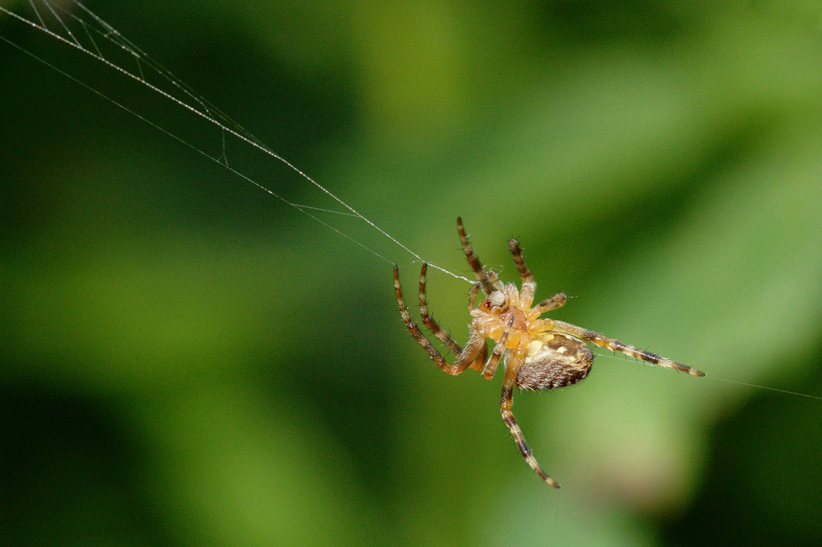
Web Traffic/Wiki Referrals

Slide 20
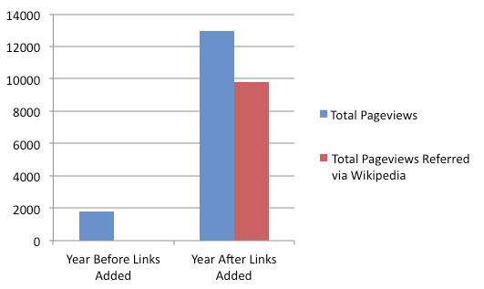
“Using Wikipedia to Enhance the Visibility of Digitized Archival Assets” (Szajewski 2013)
DLib Magazine: http://www.dlib.org/dlib/march13/szajewski/03szajewski.html

Slide 21
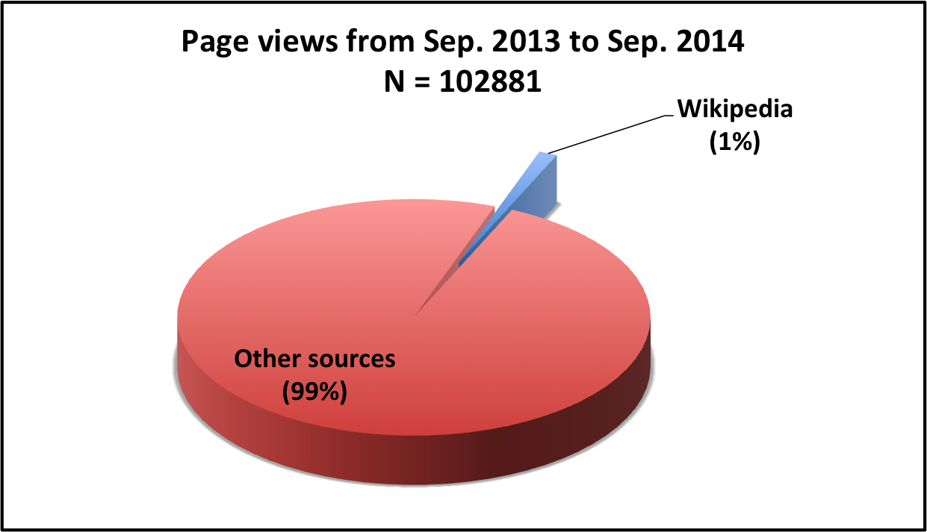
UM Finding Aids: Total Web Traffic

Slide 22
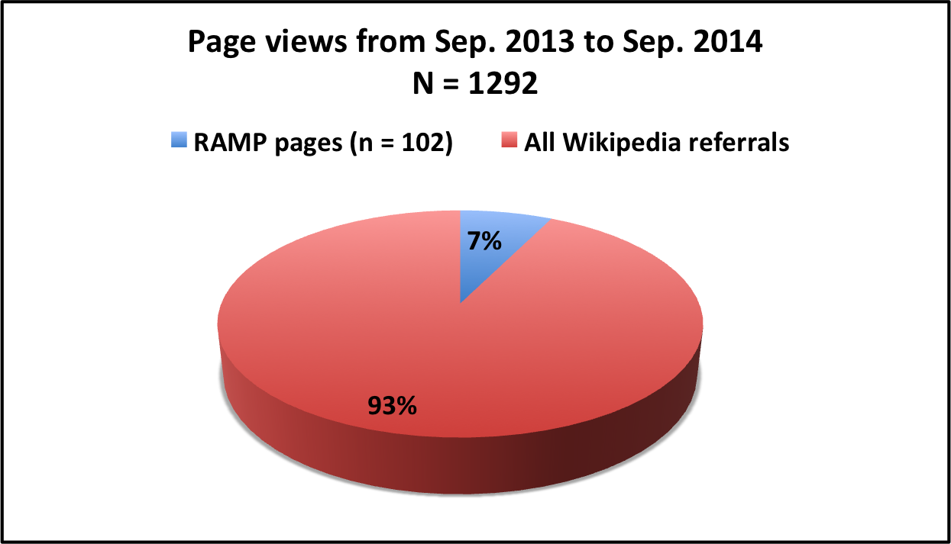
RAMP Pilot Pages in Context

Slide 23
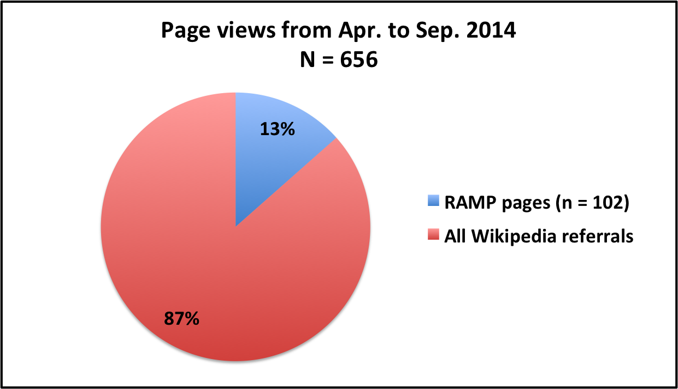
RAMP Pilot Pages in Context

Slide 24
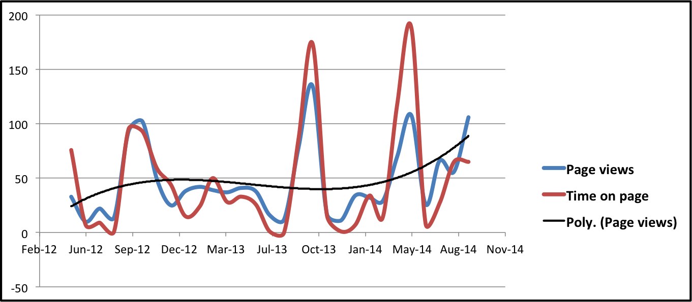
Trendline for RAMP Pilot Pages
All traffic to RAMP finding aids (May 2012 to Sep. 2014)

Slide 25
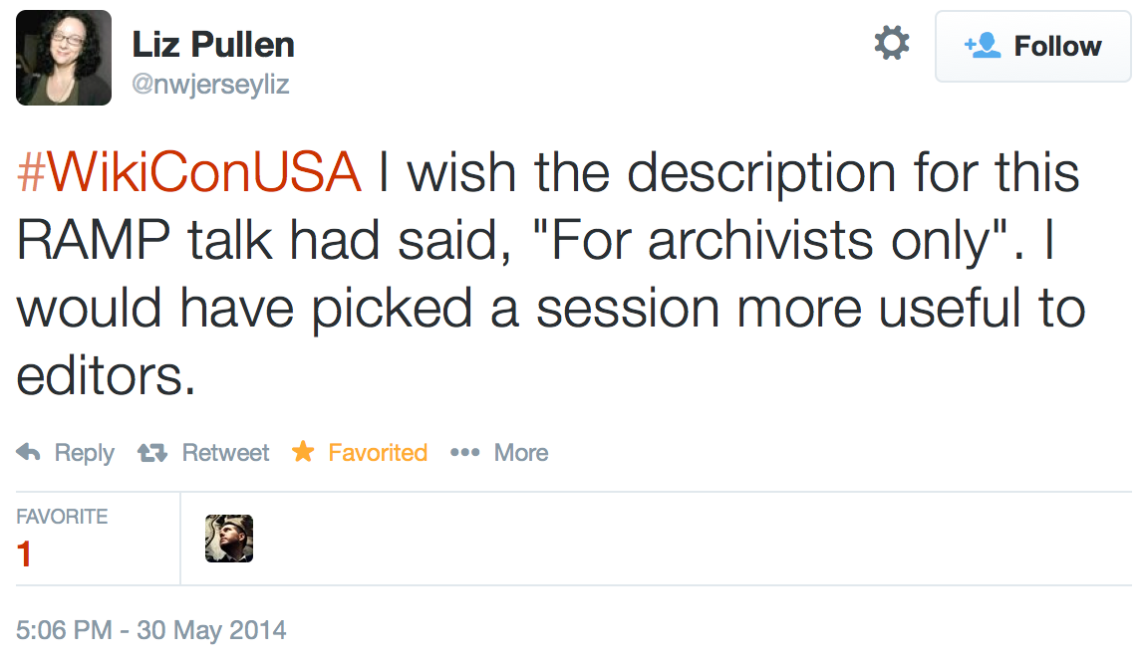
For Archivists Only?

Slide 26
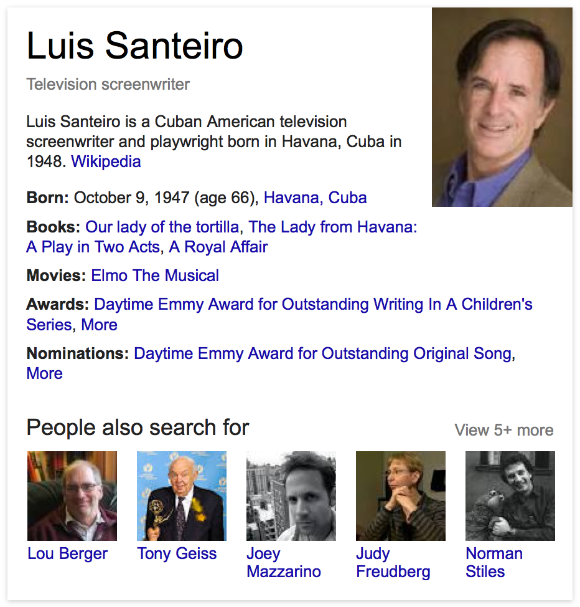
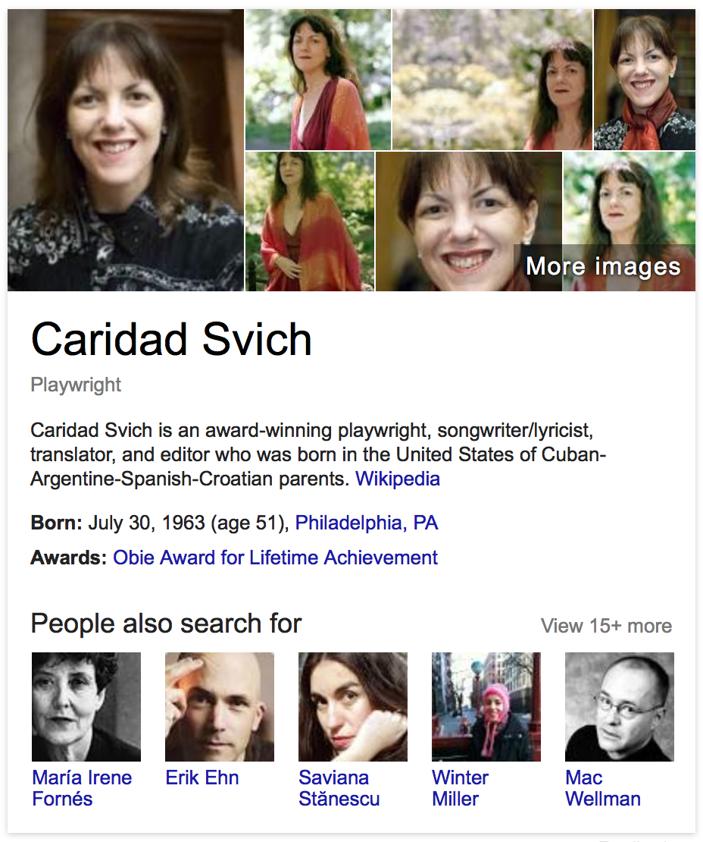
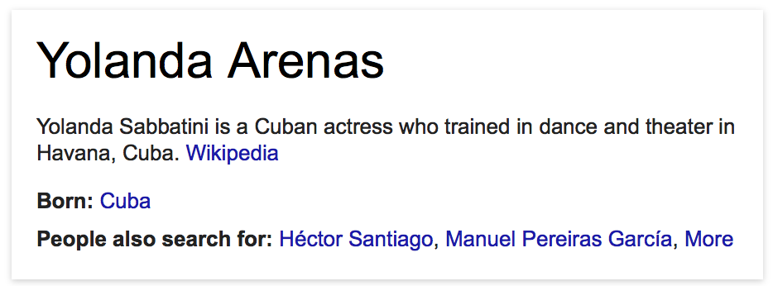
Google Knowledge Graph

Slide 27
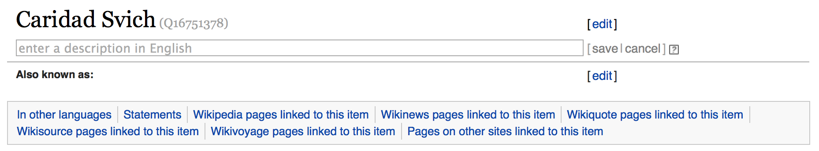
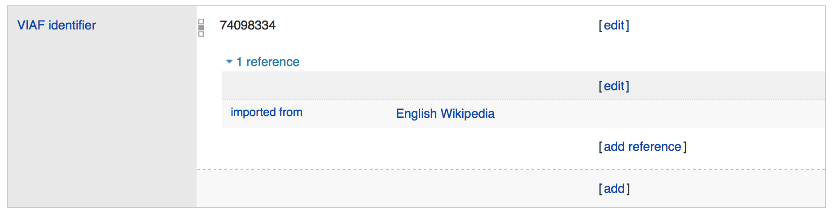
Wikidata

Slide 28
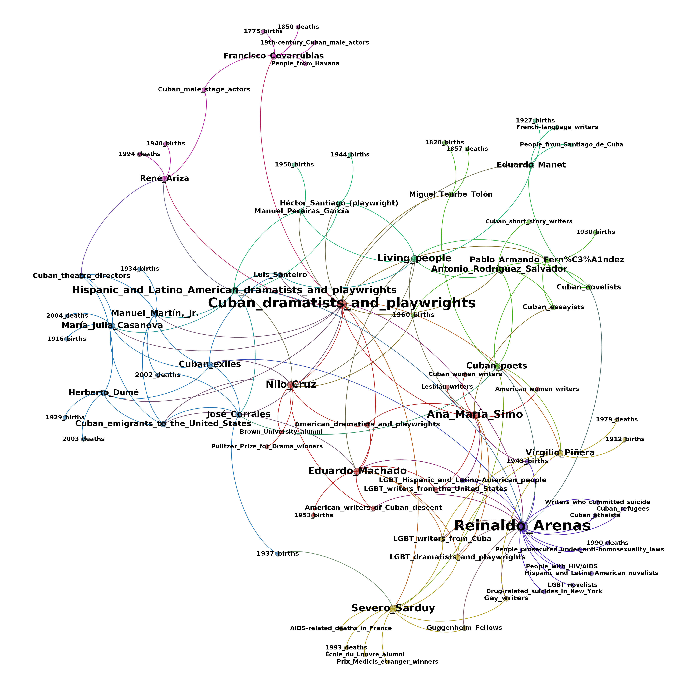
DBpedia
Network graph generated in Gephi from DBPedia SPARQL query results

Slide 29
Image Credits
archive_w_7295 by Aureusbay is licensed under CC BY-NC 2.0
Image from page 130 of "Trolley trips through New England" is a public domain image
RAMP by Carl Spencer is licensed under CC BY-NC 2.0
Female Olympic swimmer entering the pool by University of Miami Libraries
The Future by (OVO)-Artist Unknown is licensed under CC BY-NC-SA-2.0
Weaving its sticky web by Brangal is licensed under CC-BY-NC-SA-2.0

Slide 30
Acknowledgements
University of Miami Libraries
Cataloging & Metadata Services
Matt Carruthers
Mairelys Lemus-Rojas
Allison Jai O’Dell
Web & Emerging Technologies
Andrew Darby
David González
James Little
Library Communications
Sarah Block
Cuban Heritage Collection
Special Collections Division
University Archives

Slide 31

Thank you!
Tim A. Thompson Princeton University Library @timathom
©2014 Timothy A. Thompson and Mairelys Lemus-Rojas. This work is licensed under a Creative Commons Attribution 3.0 Unported License. Suggested attribution: “This work uses content from ‘Leveraging Wikipedia as a Hub for Data Integration: the Remixing Archival Metadata Project (RAMP)’ © Timothy A. Thompson and Mairelys Lemus-Rojas, used under a Creative Commons Attribution license: http://creativecommons.org/licenses/by/3.0/.”

